Slide 1
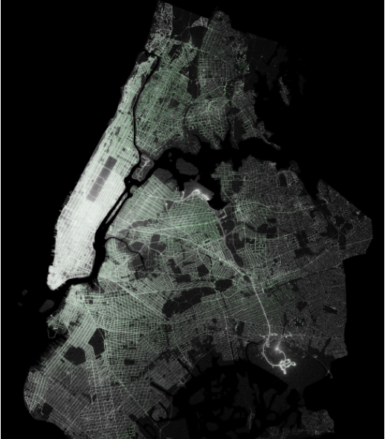
Improving traffic in New York City
overall_1_131816087101260586 columns_1_131816087101260586
A case study based on NYC‘s taxi trip dataset

Slide 2
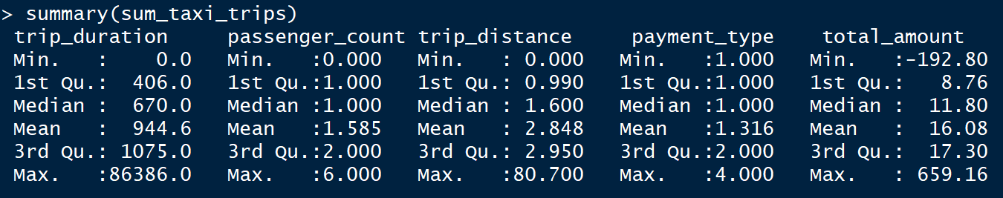
overall_1_131816083497532994 columns_1_131816083497532994
Learnings from summary statistics: 1. 50% of trips take less than 11 minutes. 2. Mostly single passenger rides 3. 75% of trips drive less than 3 miles. 4. Roughly 75% pay with credit card. 5. 50% of trips cost less than $12
Mostly short-distance trips paid by credit card

Slide 3
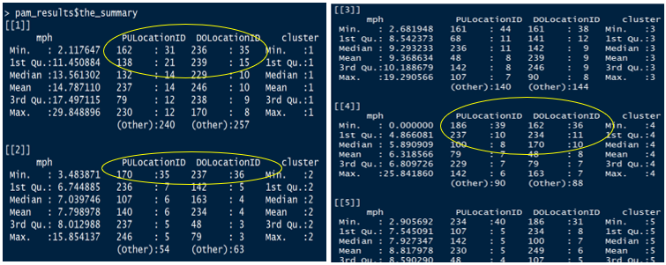
Cluster analysis Exploring the data
overall_1_131816083621877440 columns_1_131816083621877440
Cluster 1: Grand Central Parkway
Cluster 2, 3, 4: Traffic hot spots

Slide 4
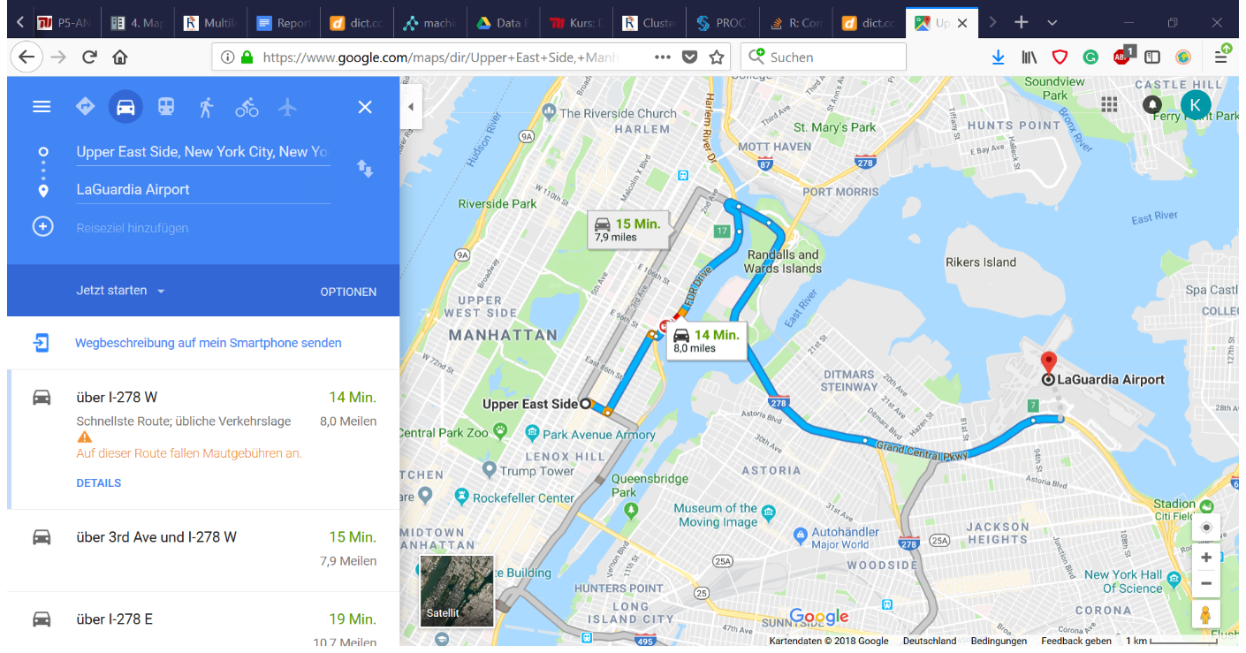
overall_1_131816084057885760 columns_1_131816084057885760

Slide 5
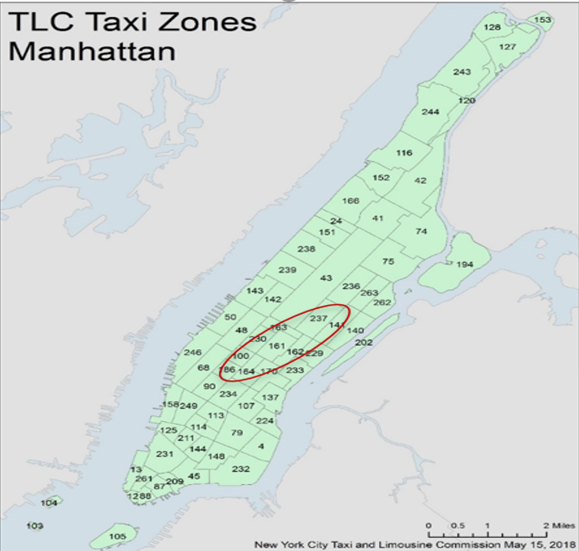
Traffic hot spots in NYC
overall_1_131816084075129638 columns_1_131816084075129638

Slide 6
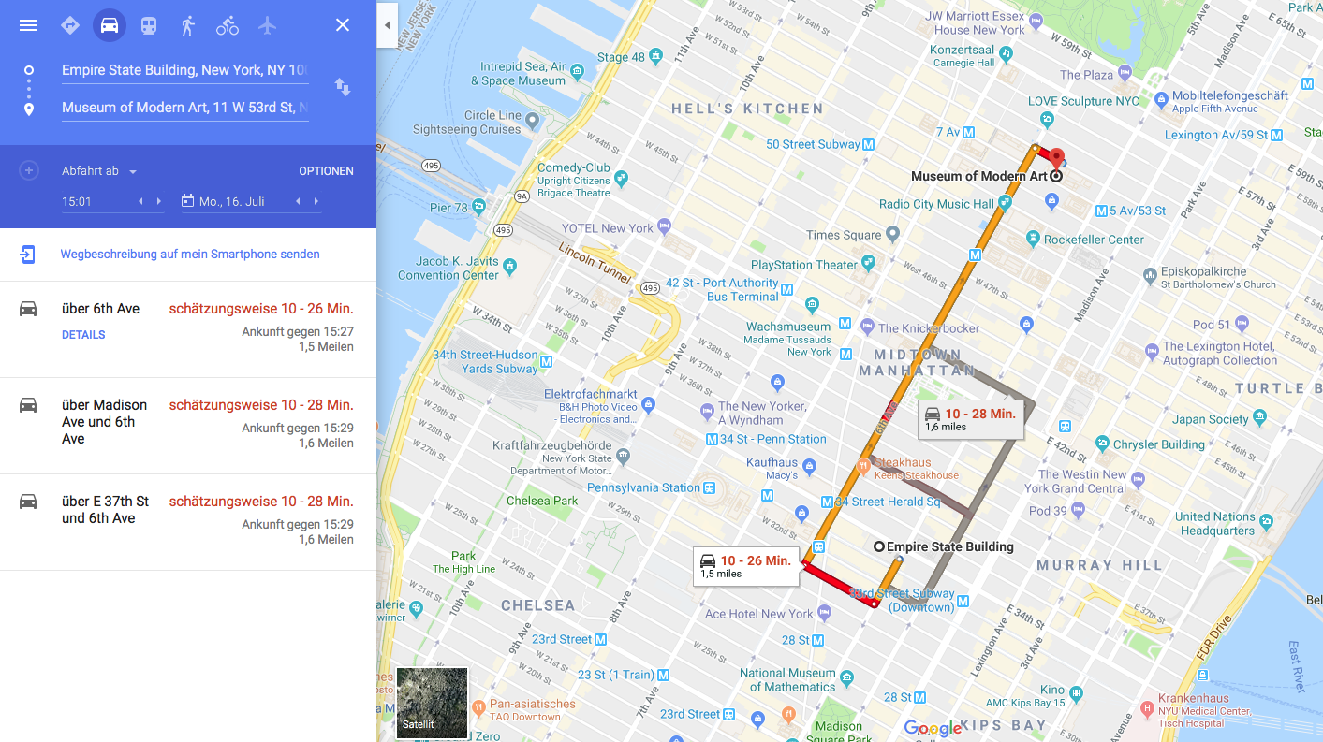
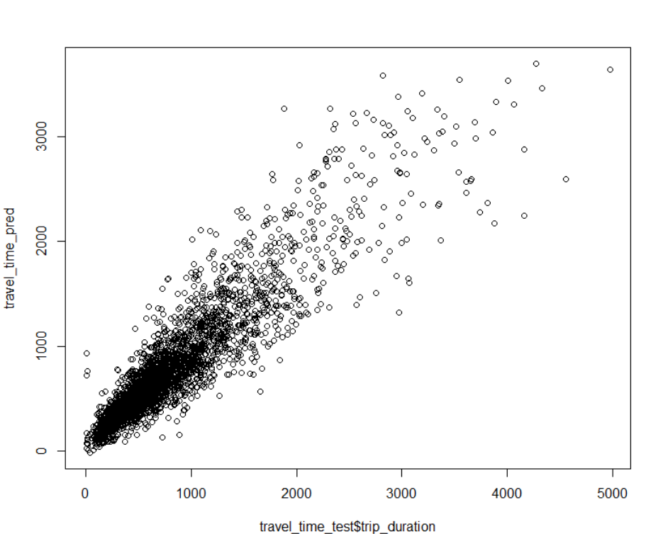
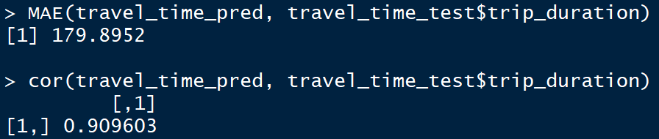
Building prediction models SVM-based duration estimator
overall_1_131816084101131284 columns_1_131816084101131284
Google‘s prediction for a typical taxi trip in Midtown Manhattan can vary significantly, e.g. ranging from 10 to 26 minutes.
Our SVM-based predictor learnt clear patterns, i.e. correlation = 0.9, and predicts trip duration with a MAE of 3 minutes.

Slide 7
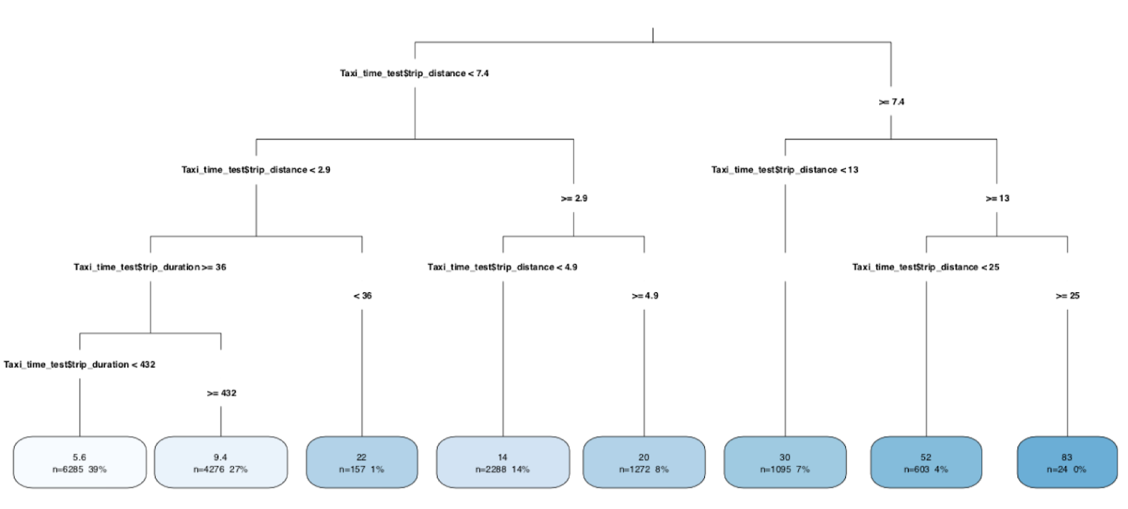
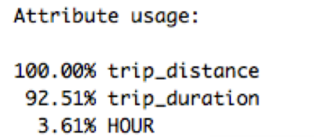
Building prediction models Understanding the taxi business model
overall_1_131816084632118500 columns_1_131816084632118500

Slide 8

overall_1_131816084702085147 columns_1_131816084702085147
Conclusions and policy advice
Support identified traffic hot spots with additional public transport capacities.
Incentivize people to use public transport by providing them a more realistic overview w.r.t. their mobility options, here a trip duration predictor.
Restructure taxi business model by introducing taxes for rides in overcapacity districts or during rush hours.

